Slide 1

Attendance for Impact
Analyzing Academic Performance Through Data

Slide 2
Introduction
What is Attendance for Impact?
How It Works
Attendance for Impact is a powerful Streamlit application that provides deep insights into student performance and attendance patterns. This innovative tool goes beyond basic attendance tracking, allowing educators and administrators to uncover hidden trends and refine policies for maximum impact.
Attendance for Impact is able to uncover hidden patterns and trends within the attendance data. This allows the application to provide educators and administrators with a comprehensive view of student engagement and performance.
The insights surfaced by Attendance for Impact are presented through intuitive data visualizations, giving users a clear and actionable understanding of the factors impacting student attendance.
At its core, Attendance for Impact is designed to analyze student attendance data, identifying key factors that influence academic success. By surfacing these insights, schools and institutes can make informed decisions to support student engagement and improve overall outcomes.
Through intuitive data visualizations and advanced analytics, Attendance for Impact empowers users to explore the nuances of attendance and its relationship to student achievement. With this information, educators can develop targeted interventions and refine attendance policies to better serve their unique student populations.

Slide 3
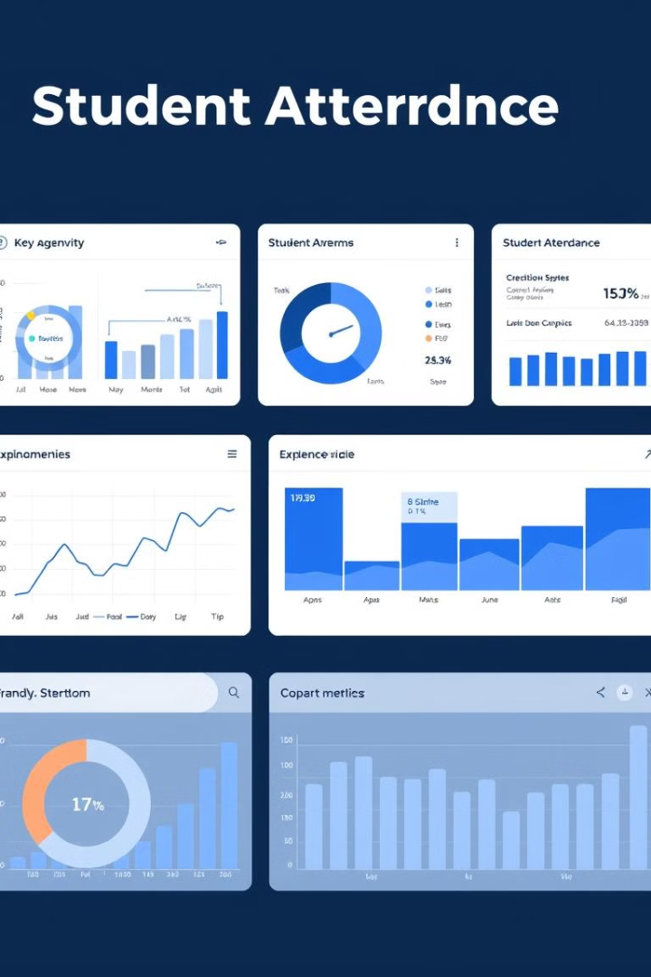
Features & Capabilities
1
Drag-and-Drop Upload
Supports XLS, XLSX files.
2
Data Visualization
Interactive graphs.
3
Statistical Analysis
Calculates correlations.
4
Personalized Insights
Simple guidance.

Slide 4




Technologies Used
Python
Pandas, NumPy, Scipy
Matplotlib, Seaborn
Core programming language.
Data manipulation.
Data visualization.

Slide 5
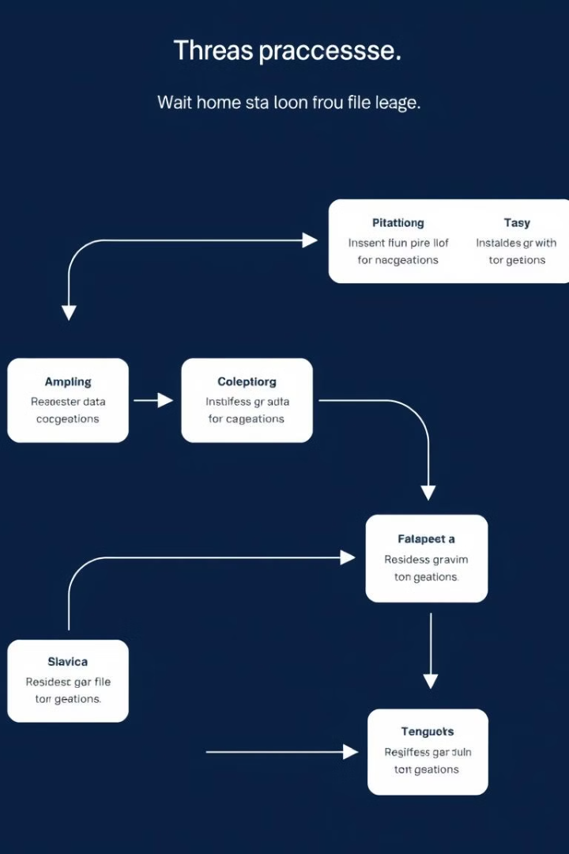



Data Processing & Custom Deque System
Excel File Handling
Accepts .xls and .xlsx formats.
Drag and Drop
Quick file analysis.
Custom Deque
Keeps latest feedback.

Slide 6

Conclusion & Impact
Actionable Insights
Data-Driven Decisions
Improve academic policies.
Better student outcomes.
Easy Recommendations
Simple to understand.

